Slide 1
Clouds of war
Rise of Dictators

Slide 2
State Standards:
8.3.1 Identify the countries affected by the totalitarian states and their acts of aggression and expansion considering geographic location.
8.5.2 Understand the changing dynamics of American life during WWII.
Performance indicator state:
8.1 identify the causes of WWII ( i.e., Treaty of Versailles, fascism, failure of the league of Nations, economic World wide difficulties).
8.5 Interpret a time line of major events from WWII.
8.7 Recognize WWII alliances.

Slide 4
What do you think about the Treaty of Versailles?
What did president Wilson predict would happen?

Slide 5
The Rise of Totalitarian Leaders
European struggles and dissatisfaction during the postwar years had a major effect on European politics.
Leaders who reflected the people’s bitterness and anger emerged.
These leaders promised a return to greatness.
This was very appealing to unhappy Europeans, and many were willing to give up basic freedoms in return for future glory.

Slide 6
Adolf Hitler was the most destructive dictator of modern times.
He was not really a German, because he was born in Austria.

Slide 7
Hitler was high school dropout, he wanted to be an artist, but he failed the admissions examination twice.
In WWI he joined the German army. He was gassed and wounded, and never reached a rank higher than corporal.
After the war was over he helped to organize the Nazi Party.

Slide 8
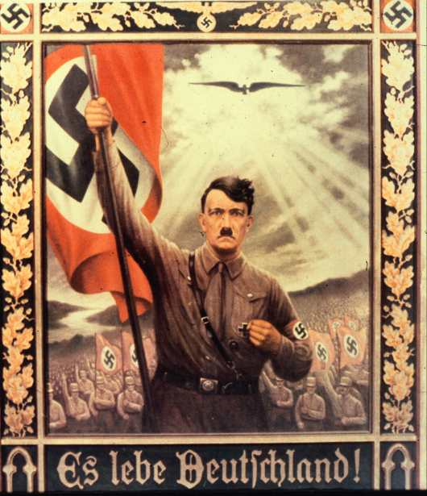
Notes:
Hitler holding Nazi Flag

Slide 9
In 1923 he and some members of the Nazi party tried to take over Germany by calling for a revolution.
He was put in prison, and while he was there he wrote Mien Kampf ( my struggle)Which became the Nazi bible.
He declared that the Germans were the “master race” entitled to rule the world.

Slide 10
..\..\My Videos\WWII\Imprisonment_and__i_Mein_Kampf__i_.asf

Slide 11
He said that democracy was a fraud, and the only good government was a dictatorship.
He said that Christianity was a fraud created by the Jews to make cowards out of the master race.
Most people outside Germany did not take Hitler seriously, but inside Germany millions were joining the Nationalist Socialist Party (Nazi)

Slide 12
The people inside Germany resented the Treaty of Versailles and the reparations they had to pay.
As a result of the heavy payments they had to pay inflation ran wild.
Money lost its value so quick that wages had to be paid every 24 hours.
Peoples life savings became worthless.

Slide 13
He organized spectacular meetings with swastika flags flying and thousands of people listened to his hour long speeches of hate and glory.
His thugs beat up and assassinated his political opponents. He sent millions to concentration camps.
The Germans made Hitler their god.

Slide 14
..\..\My Videos\WWII\hitler early years.asx

Slide 15
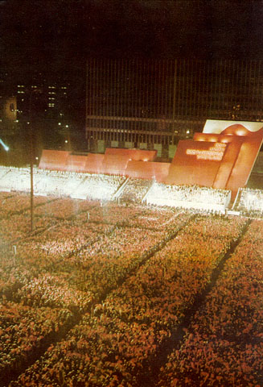

Slide 16
Benito Mussolini led the Italian government by 1922.
He encouraged the use of violence against Socialists and Communists, whom many Italians blamed for the chaos of postwar Italy.
He gained wide support for his views.
Angry over the Treaty of Versailles, he founded the National Fascist Party.
Fascism stressed the glory of the state—the rights and concerns of individuals were of little importance.
“All within the state, nothing outside the state, nothing against the state.”
Established a dictatorship that allowed no other political parties
Had total control over daily life in a totalitarian regime

Slide 17
Other Totalitarian Regimes
Spain
Spain erupted into civil war during the 1930s.
General Francisco Franco came to power during this conflict.
He was a fascist.
Japan
Torn apart by political and economic conflict
Military leaders used violence to gain control over the government.
They were inspired by nationalistic dreams of Japanese greatness.
Soviet Union
Communism and fascism represent opposite political extremes.
Yet, under Joseph Stalin, communism was similar to fascism. He crushed all political opposition.
Stalin dominated all areas of Soviet life.
One of the era’s most notorious totalitarian dictators

Slide 19
..\..\My Videos\WWII\Communism_and_Fascism.asf

