Slide 1
CLAIBORNE COUNTY SCHOOLS Ethics Training
Increasing Awareness

Slide 2
Why Do I Need This Training?
Tenn. Code Ann. § 49-5-1003
Teachers MUST adhere to the Tennessee Teacher Code of Ethics
Includes revised components that prohibit inappropriate relationships
Requires annual professional development for teachers on the code of ethics
Requires teaching programs to include a class on ethics
Notes:
Because of Tad Cummins and other news stories like his.

Slide 3
Teacher Code of Ethics
Teachers MUST abide by the code of ethics
Abide by all federal and state laws
Deliver professional nondiscriminatory educational practices
Respect constitutional rights of students
Interactions must take place in a transparent and appropriate setting
Must NOT knowingly make false or malicious statements about students or colleagues Do Not Gossip!
Must NOT engage in any sexually related behavior with student whether verbal, written, physical, or electronic-with or without the student’s consent
Must NOT furnish alcohol or illegal or unauthorized drugs: and strive to prevent the use of such when the student is under the educator’s supervision, on LEA premises, during school activities, or in private settings
Refrain from alcohol use while on school premises or LEA, or during school activity where students are present
Teachers must not misrepresent professional qualifications
State mandated testing must be administered fairly and ethically
Any teacher that has knowledge of another educator in breach of the code of ethics, must disclose breach to supervisor and LEA

Slide 4
Ethics
Outline of training:
Cultural Competence
Definition of ethics
Ethical challenges in schools
4 Guiding Principles
Ethical relationships-social media
Products, privacy, plagiarism
TN Code of Ethics
Definition of race and culture
Valuing diversity
Culturally competent classrooms
Best teaching practices

Slide 5
“Ethics”-how do you define it?
Character
Values
Beliefs
“I’m basically a good person.”
“She is so loyal.”
“I trust that woman with my life.”
“Honesty is the best policy.”
“Be a person of integrity.”
“Are you someone I can count on?”
“Do unto others as you would have others do unto you.”
“Karma will find you.”
“That would be against my convictions.”
Notes:
Ask people to give definitions for “ethics”. Ask if it is just about character traits or do values and beliefs come into play?

Slide 6
Background Influence
Upbringing
Education
Employment
What were you taught about ethics?
Were there certain values your parents instilled that you remember?
What did you learn in college about ethics?
Did any of your courses teach ethics?
Were any potential scenarios that you might face shared with you?
What training have you gotten on ethics?
Have you followed any codes of ethics for organizations?
Are you aware of what constitutes “crossing the line”?
Decision-making processes develop over the lifetime of a person and are affected by experience.
Notes:
Have staff share stories of upbringing and sayings they remember hearing as a child or teen. Ask how do they know what is considered unethical in their employment?

Slide 7
Ethics Definition:
The system or code of morals of a particular person, religion, group, or profession
“The problem is we don’t realize the ethical implications of an interaction.” (Mackenzie)
Sound decision-making skills are the essence of the ethical process.
max goth
Notes:
Discuss how it really boils down to how we make our decisions about situations we face. Those decisions are influenced by our background and experiences.

Slide 8
Why ethics discussions
are needed:
What if you are asked to change a student’s grade?
How would you handle learning a co-worker misused club funds?
What if an administrator asked you to falsify data?
What if a team player lets you do all the work and takes credit?
Notes:
We hear so many news stories of good employees who make bad decisions and ruin their jobs, lose family, and become a public spectacle.

Slide 9
Consider this scenario:
Sitting in a restaurant, a parent overheard a conversation from a lady who volunteered at a school. She discussed how a particular student was always texting on her cell phone, dressed like a “slut” and cursed like a sailor. The parent was very angry and called the principal to report what she had heard. The principal asked the school staff to speak with the volunteer to remind her of the rule of confidentiality. Instead of speaking directly to the volunteer whose name was mentioned, a blanket statement was sent out through email to all volunteers reminding them of the rules. When asked about the status of the situation later, the school staff told the principal that it had all been taken care of.
Notes:
What are some of the issues you see in this scenario? Confidentiality, honesty, confronting issues… Realize that even when you are outside of the school setting, your behavior can have an impact. It is important to train volunteers to uphold the rule of confidentiality.

Slide 10
Ethical Challenges in Education
Students/Parents
Colleagues
Administration
Civility-the way we treat others
Being role models
Parental status/community standing
Conflict of interest
Memberships and affiliations
Non-school employment or business (2nd jobs)
Bullying colleagues (maliciousness)
Abuse of power
Discrimination
Taking credit for others’ work
Utilizing resources
Notes:
Ask people to give definitions for “ethics”. Ask if it is just about character traits or do values and beliefs come into play? Do we have a responsibility outside of our work environment?

Slide 11
Another scenario:
As a guidance counselor you are faced with the challenge of placing students in their classes. During this week, you have fielded many calls from parents concerned that their students might be placed in a particular teacher’s class who seems to have issues with wealthy students. In fact, it’s being reported that this teacher picks on the students from wealthy families. You decide to go and talk with the teacher about this. When asked if she has a problem teaching these students, she replies with, “I actually like teaching them. Most of them need to be taken down a notch and I can help them by showing them they are no better than others. It is good for the whole class when I can make an example out of them. That’s my approach and it’s worked for years. My test scores are
great and by the end of the year all the parents are happy.
Notes:
How would you respond to this teacher? Would you take any action?

Slide 12
4 Rules to Live By
Golden Rule
Mutual respect for others
Benevolence
Ways that conduce the greatest good for the greatest number of people
Notes:
We sometimes have higher expectations for others’ behavior than we do our own. We must show mutual respect for each other and treat others as we would like to be treated.
Sometimes we have to give up what we want for the good of the whole. Sometimes our self-interest conflicts with good ethical behavior.

Slide 13
4 Rules to Live By
Universality
Is it acceptable if everyone does it?
Publicity
What if everyone knew about it?
Notes:
If everyone chose to do the action that you are contemplating, what would be the outcome? Everyone takes an extra ream of paper…
If you knew you were being watched, would you do this particular thing?

Slide 14
Ethical Relationships
Educator to student
Educator to parent
Educator to educator
Educator to administrator

Slide 15
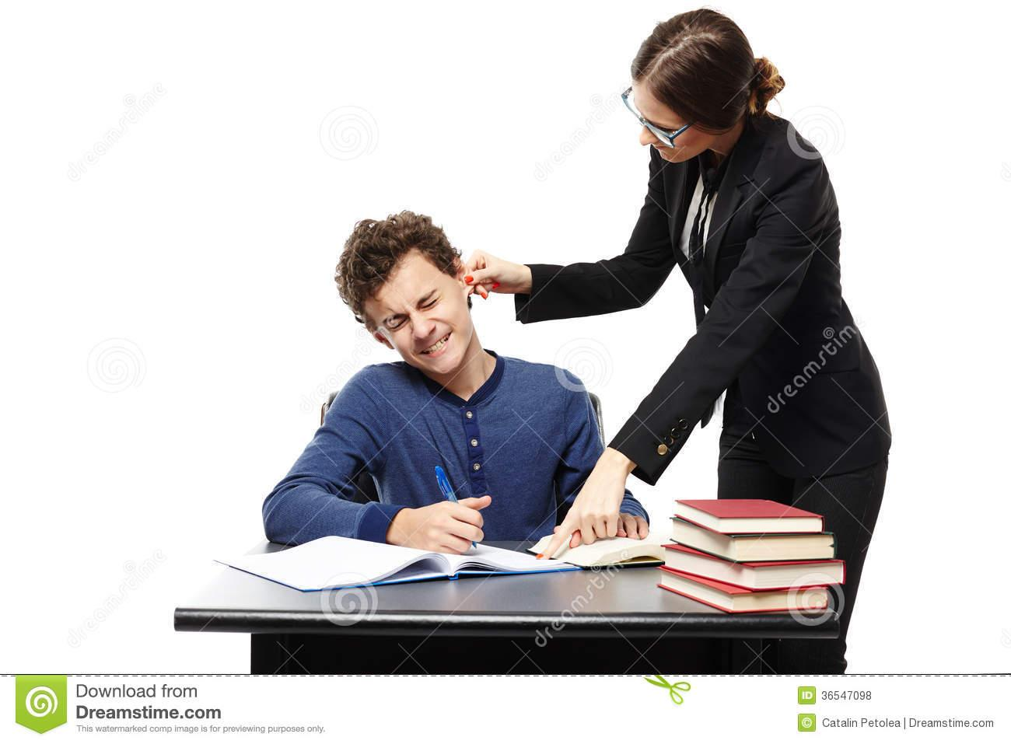
Educator to Students
Develop strong boundaries
Consider the broad impact on school and community
Model good ethics for students
Follow rules and policies
Consult with others when unsure
Advocate for students’ needs
Notes:
These are things to consider when working with students to protect yourself. Advocate for students even when you see co-workers acting inappropriately with students.

Slide 16
Educator to Parents
Maintain a transparent and consistent grading system
Set clear expectations at beginning of school year
Know when, what, and how to communicate with parents
Maintain the best interests of the students when making decisions
Establish professional boundaries
“Rationally detach” from negative interactions
Notes:
Ethical considerations to prevent issues with parents. There can be very tricky situations if appropriate boundaries aren’t set and expectations aren’t communicated. You aren’t here to be friends with the parents-keep personal/social lives separate. Find ways to emotionally detach from negative experiences and try not to take personally.

Slide 17
Educator to Educator
Be willing to examine, question, and challenge issues, using diplomacy
Be open and honest in your interactions
Support and hold each other accountable
Carry your weight as a team member
Give credit where credit is due
Increase self-awareness and awareness of “red flags”
Avoid negativity
Maintain professional relationships
Minimally share personal information
Be trustworthy and respect confidentiality
Notes:
Explain how if these bulleted items are carried out, the likelihood of unethical behavior occurring can be minimized. Teams are vital to our success and can help in these areas.

Slide 18
Educator to Administrator
Be prepared to meet your professional responsibilities
Demonstrate respect for leaders even when you disagree
Choose truth vs. loyalty
Admit to mistakes
Uphold the standards to the profession
Honor the rules and policies
Put forth your best all the time
Inform leaders of issues with potential complications
Notes:
Discuss issues of friendship over telling the truth about concerns. Respecting leaders publicly and discussing concerns privately with them. When you make a mistake, don’t try to cover it up-come clean and accept responsibility and learn from mistakes. Don’t go behind their backs and do what you want or what you think is best. We should strive to make our leaders shine.

Slide 19
Scenario
Ms. Garcia and Ms. Ming are both sixth-grade English teachers. Ms. Garcia, a new teacher at the school, has additional certification in gifted education. Ms. Ming has been a certified English teacher for a number of years. Ms. Ming has been overheard making negative comments about Ms. Garcia’s teaching ability and about Ms. Garcia personally in the faculty lounge. Mr. Daniels, the sixth-grade history teacher, has heard Ms. Ming making negative comments about Ms. Garcia on more than one occasion and he knows that these comments are false. He also knows that Ms. Ming has been angry that Ms. Garcia was asked to teach the advanced English class. This is a class Ms. Ming had expressed a desire to teach. He believes this contributes to her negativity toward Ms. Garcia. What should he do? What would you do?

Slide 20
Resolution
Mr. Daniels is in a very difficult situation, knowing that Ms. Ming is making false statements about Ms. Garcia. What should he do? According to NEA’s Code of Ethics under Principle II: Commitment to the Profession, Indicator Seven states that educators “shall not knowingly make false or malicious statements about a colleague” (NEA, 1975). (Also in the Tennessee Teacher Code of Ethics)
Mr. Daniels should talk to Ms. Ming about his interest in maintaining positive professional relationships with all the members of the school team. He might point out the numerous strengths of all the team members, the benefits of teamwork and collaboration, and the usefulness of the NEA Code of Ethics. Depending on his willingness to intervene, he might offer to help the two teachers find common ground, starting with students, school initiatives, or parent and community projects.

Slide 21
Social Media

Slide 22
Sticky Issues to Avoid
Social Media
Do you allow parents to “friend you” on social media?
Do you post questionable pictures on your social media?
Do you give students access to your social media?
Email (public access ?)
School Resources
Is it ok to use the school copier/printer for personal use?
Do you feel entitled to “extra” supplies?
Do you “borrow” school equipment?
Do you use co-workers’ things without permission?
Notes:
Some of these may seem harmless, but many times can be a source of trouble for a teacher. Discuss the importance of only using work email for professional purposes and keeping it professional. This can be obtained by the public and used in court. Even attachments!

Slide 23
Sticky Issues to Avoid
Copyright/Plagiarism
Do you ever copy materials that are protected by copyright laws?
Do you “share” resources that are meant for one license?
Do you create presentations without giving proper credit to sources?
Common Sayings
“Everyone does it.”
“It’s not illegal.”
“It’s not like anyone will notice.”
“They owe me this with as much time as I work.”
Notes:
There are many reasons why we do these things, i.e. save money, not enough time, feeling of justification because of personal funds spent, but it doesn’t mean these are ethical actions. If you find yourself trying to justify your behavior, you may want to consider if it is the most ethical decision you could be making.

Slide 24
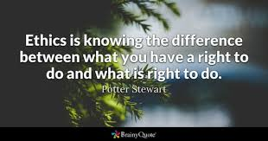
Remain Professional in ALL Aspects of Your Profession

Slide 25
References
Tough Choices for Teachers by Robert Infantino and Rebecca Wilke
Now What? Confronting and Resolving Ethical Questions by Sarah V. Mackenzie & G. Calvin Mackenzie
State of Tennessee Code of Ethics

